Slide 1
Transformers: Advanced Topics
Plaban Kumar Bhowmick
Department of AI
plaban@ai.iitkgp.ac.in

Slide 2
Transformers: Advanced Topics
Transformers: Advanced Topics
Positional Encoding

Slide 3
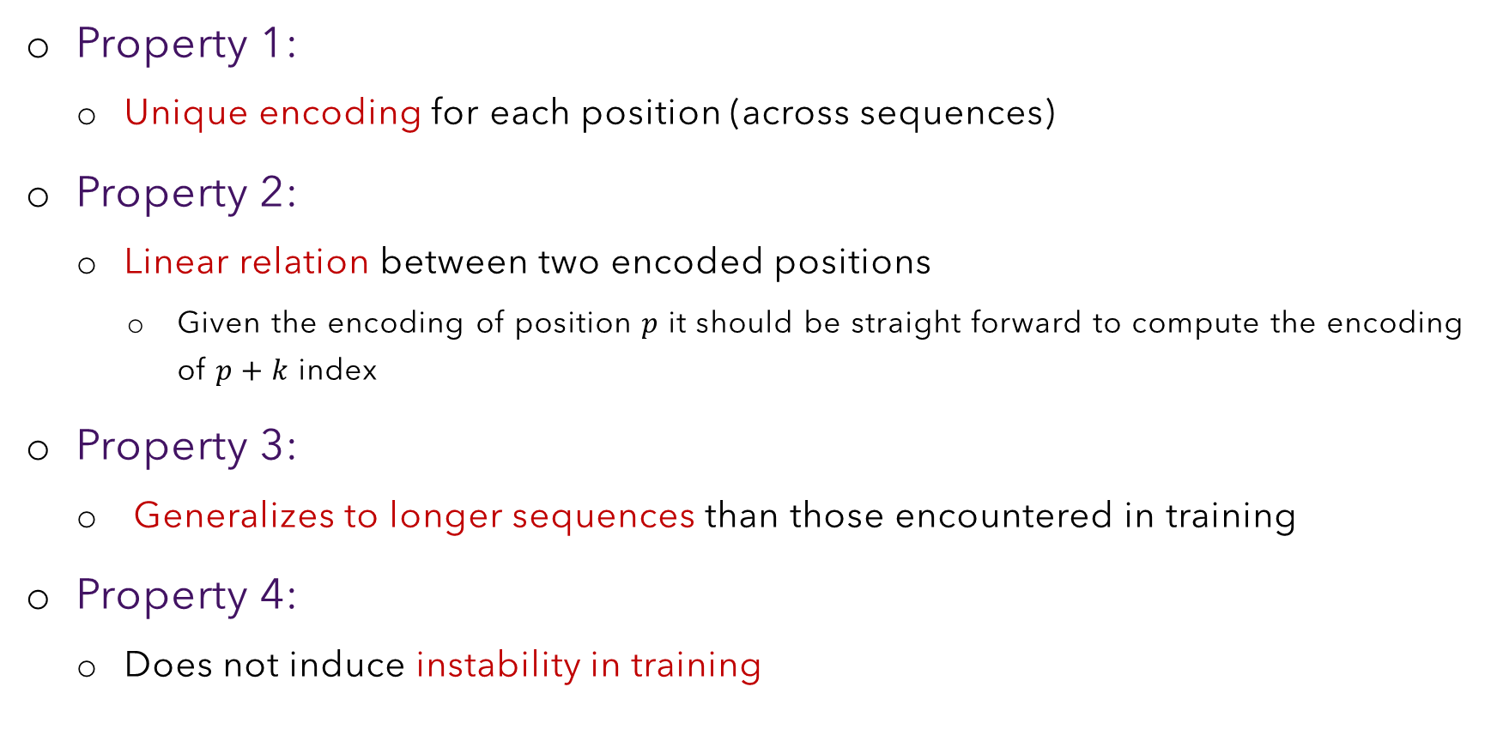
Positional Encoding: Desirable Properties
Property 1:
Unique encoding for each position (across sequences)
Property 2:
Linear relation between two encoded positions
Given the encoding of position $p$ it should be straight forward to compute the encoding of $p+k$ index
Property 3:
Generalizes to longer sequences than those encountered in training
Property 4:
Does not induce instability in training

Slide 4
Positional Encoding: A Naïve Idea
Add the positional index to the embedding
Problem:
SELF ATTENTION
The last entry of the embedding vector
is unbounded (consider a 100 page doc)
Instability in training
Violating Property 4
1
2
3
Solution:
Normalize last vector entry with sequence
length
spring
is
here
(1)
(2)
(3)

Slide 5
Positional Encoding: A Naïve Idea
Add the positional index to the embedding
Problem:
SELF ATTENTION
Counting based index values are discrete
Neural architectures hate discrete representation
Violating Property 4
1
2
3
spring
is
here
(1)
(2)
(3)

Slide 6
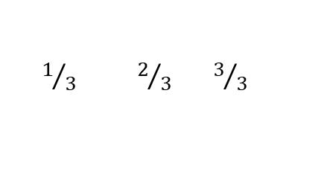



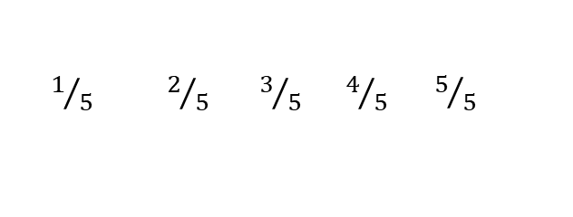
Positional Encoding: A Naïve Idea
Add the positional index to the embedding
Solution:
SELF ATTENTION
Normalize last vector entry with sequence
length
(I)
Spring is here
${ 1}/3 2/3 3/3$
(II)
Spring is in the air
$$1/3$$
$$2/3$$
$$3/3$$
${ 1}/5 2/5 3/5 4/5 { 5}/5$
spring
is
here
(1)
(2)
(3)
Different representation for the same index
Violating Property 1

Slide 7
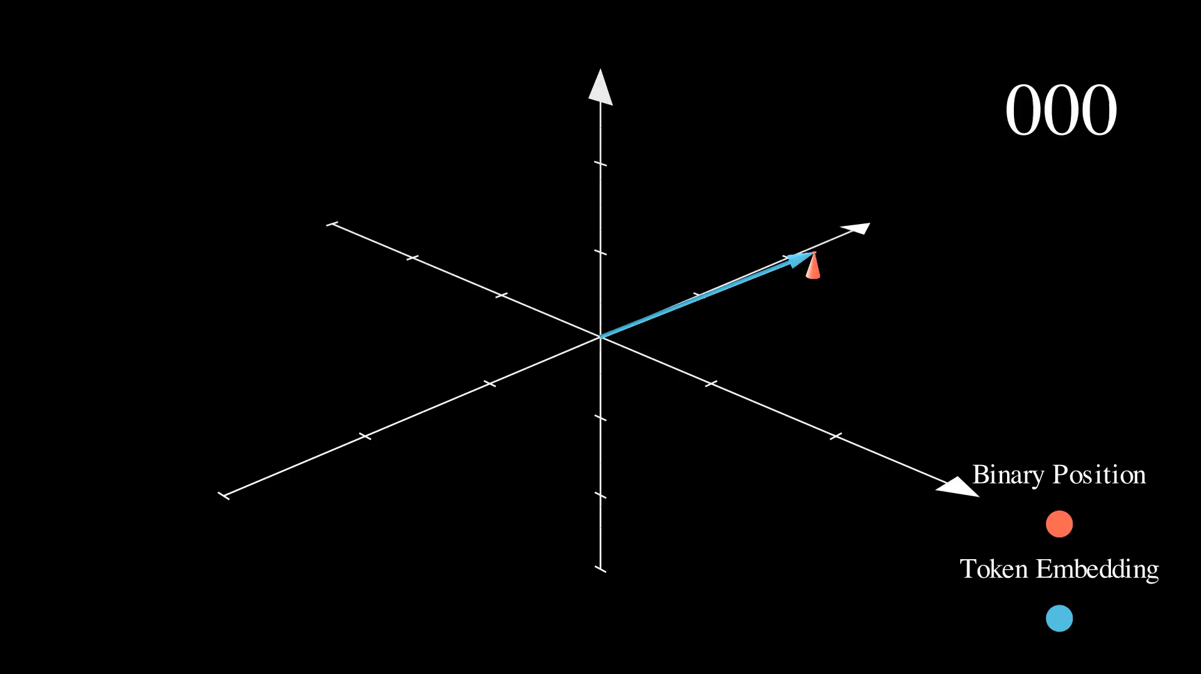
Positional Encoding: A Naïve Idea
Can we use binary representation of position index?
SELF ATTENTION
+
+
+
0 | 0 | 0 | 1
0 | 0 | 1 | 0
0 | 0 | 1 | 1
spring
is
here
The result of addition is ‘jumpy’
(1)
(2)
(3)
Optimization process likes smooth, continuous changes
Violating Property 4

Slide 8
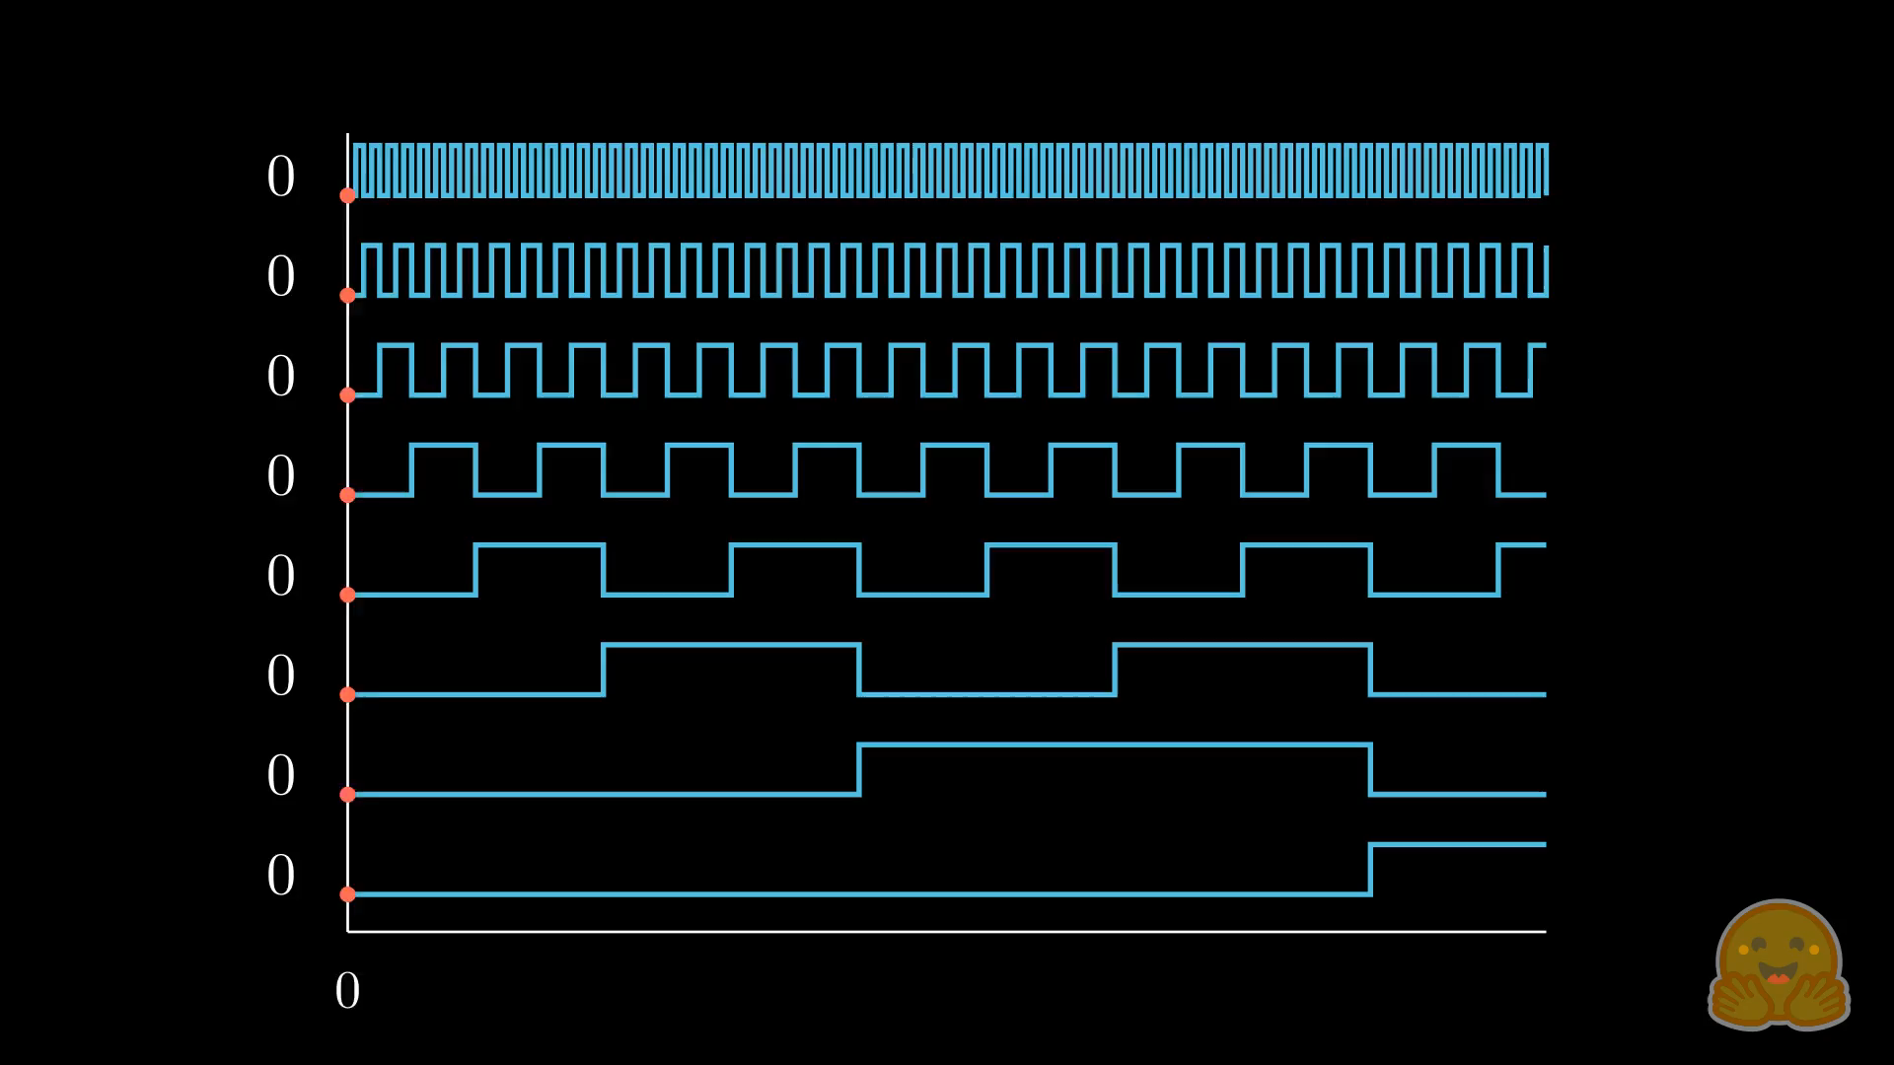
Positional Encoding: A Naïve Idea
Least Significant Bits (LSB)
Most Significant Bits (MSB)
The LSB changes in every consecutive numbers
The second LSB changes in every two numbers
The MSB changes in the slowest rate

Slide 9
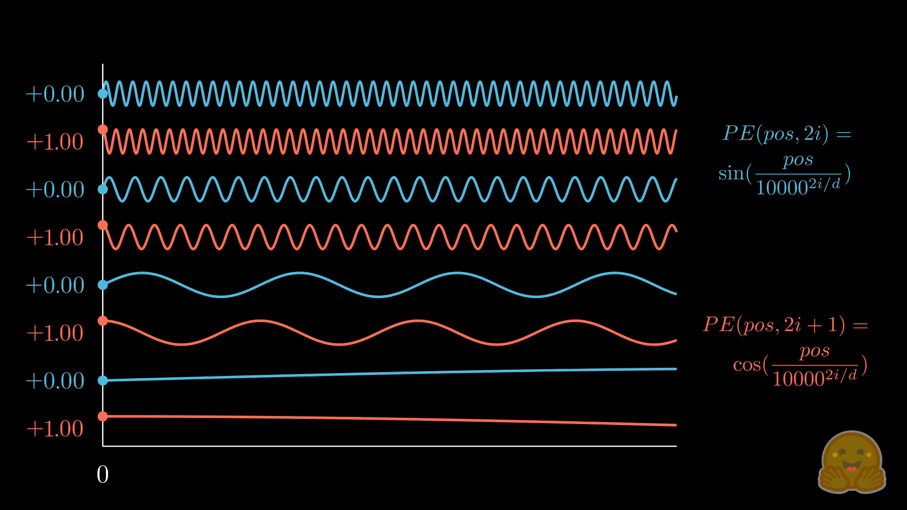
Positional Encoding: A Naïve Idea

Slide 10
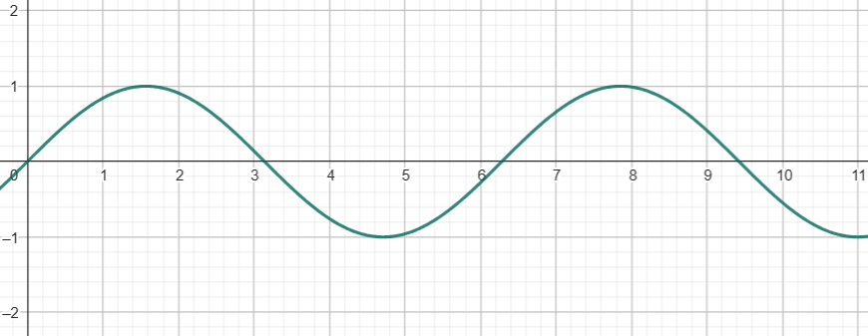
Positional Encoding: Periodic Function
SELF ATTENTION
sin(1)
sin(2)
sin(3)
Issue with periodic function:
Same value for two distinct positions
spring
is
here
(1)
(2)
(3)

Slide 11
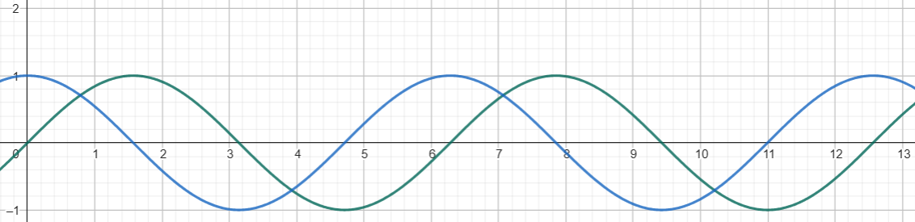
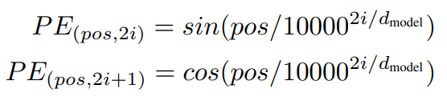
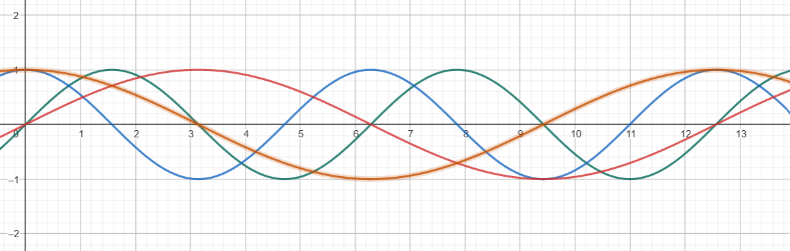
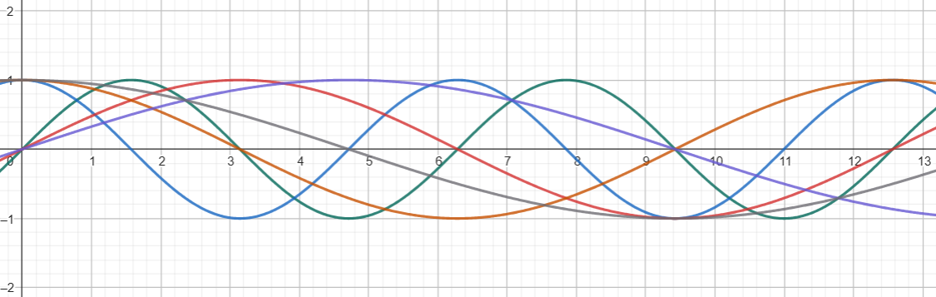



Positional Encoding: Periodic Function
Solution: Use multiple trigonometric functions
$$[sin\left(p\right)cos⁡(p)]$$
Use lower frequencies (lower the prob of repetition)
$$[sin\left(p\right) cos \left(p\right) sin\left(\frac{p}{2}\right)cos⁡(\frac{p}{2})]$$
Use lower frequencies (lower the prob of repetition)
$$[sin\left(p\right) cos \left(p\right) sin\left(\frac{p}{2}\right)\cos\left(\frac{p}{2}\right)\sin\left(\frac{p}{3}\right)\cos\left(\frac{p}{3}\right)]$$

Slide 12
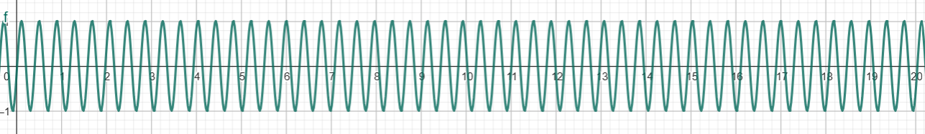
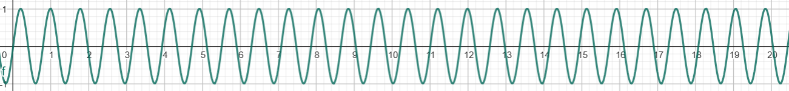
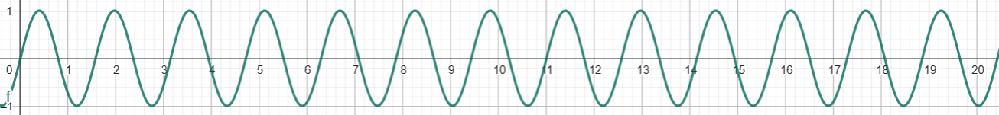
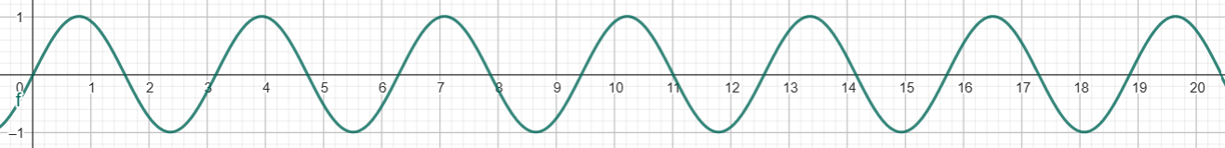
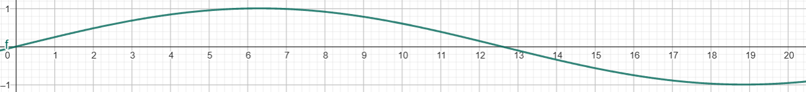

Sinusoidal Positional Encoding
pos
$$2i$$

Slide 13
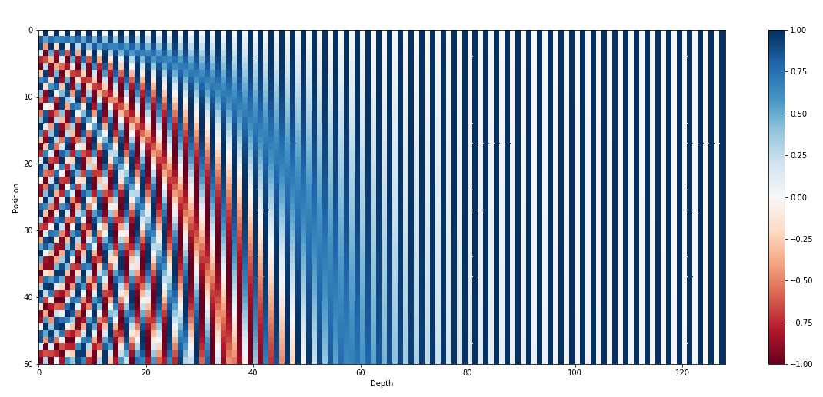
Sinusoidal Positional Encoding

Slide 14

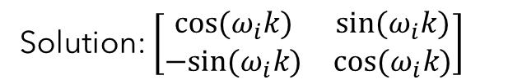


Sinusoidal Positional Encoding
Linear relation between two encoded positions (Property 2)
Let us consider a 2D positional embedding $\left[\begin{matrix}\sin{{(ω}_{i}p)} \\ \cos{(ω_{i}p)}\end{matrix}\right]$
$$ω_{i}=\frac{1}{{10000}^{{2i}/d}}$$
Our goal is to find a linear transformation matrix that can shift the functions by offset $k$
$$M.\left[\begin{matrix}\sin{{(ω}_{i}p)} \\ \cos{(ω_{i}p)}\end{matrix}\right]=\left[\begin{matrix}\sin{{(ω}_{i}(p+k))} \\ \cos{(ω_{i}(p+k))}\end{matrix}\right]$$
$$\left[\begin{matrix}u_{1} & v_{1} \\ u_{2} & v_{2}\end{matrix}\right].\left[\begin{matrix}\sin{{(ω}_{i}p)} \\ \cos{(ω_{i}p)}\end{matrix}\right]=\left[\begin{matrix}\sin{{(ω}_{i}(p+k))} \\ \cos{(ω_{i}(p+k))}\end{matrix}\right]$$
Solution: $\left[\begin{matrix}cos⁡(ω_{i}k) & sin⁡(ω_{i}k) \\ −sin⁡(ω_{i}k) & cos⁡(ω_{i}k)\end{matrix}\right]$
Rotation Matrix!!
Shift by position $k$ is equivalent to rotating the vector by an angle proportionate to $k$
Sinusoidal position encoding (2017) does not use this information
Rotary position encoding (2021) used this trick

Slide 15
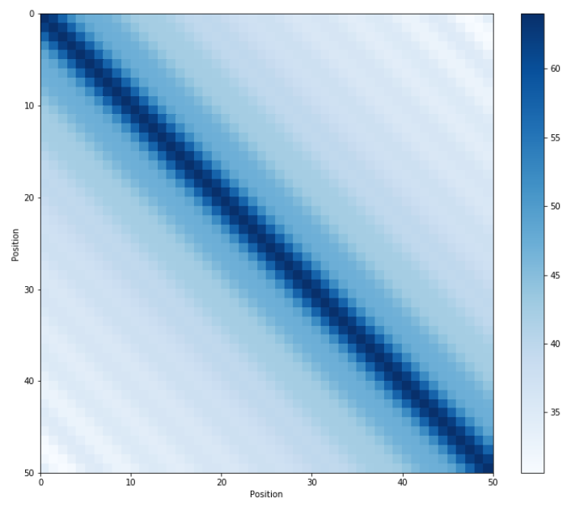
Symmetry of Sinusoidal PE
Distance between neighboring time-steps are symmetrical and decays nicely with time

Slide 16
Sinusoidal Positional Encoding
Why are positional embeddings summed with word embeddings instead of concatenation?
Doesn't the position information get vanished once it reaches the upper layers?
Why are both sine and cosine used?
What if two pairs of embedding and position vectors have the same sum?
[0.2, -0.1, 0.9, 0.03]+[0, 1, 0, 1]
[-0.5, 0.7, 0.8, 0.7]+[0.7, 0.2, 0.1, 0.33]

Slide 17

Sinusoidal Positional Encoding: Issues
(7)
(9)
happiness begets happiness
……………………....................happiness begets happiness……………………………….
(876)
(878)
semantics
position
happiness
(7)
happiness
(9)
0.1
0.2
-0.8
0.6
0.1
-0.5
0.1
0.7
0.1
0.2
-0.8
0.6
0.1
-0.5
0.1
0.7
(7)
happiness
(7)
+
happiness
$$θ$$
happiness
(7)
Change in ‘happiness’ vector
Semantics is ‘polluted’
Magnitude of the semantic vector changes
No change in magnitude of the semantic vector
→ Preserve semantics
Position information can be represented as a change
in angle.

Slide 18
Sinusoidal Positional Encoding: Issues
(7)
(9)
happiness begets happiness
……………………....................happiness begets happiness……………………………….
(876)
(878)
Semantics of a token is captured by its surrounding token, irrespective of its absolute position
happiness
(876)
happiness
(9)
happiness
(7)
happiness
(878)
$$θ$$
$$θ$$
No change in magnitude of the semantic vector
Angle between the two pairs of vectors remains the same

Slide 19
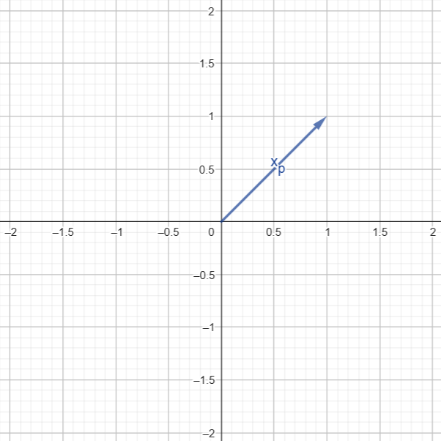







Sinusoidal Positional Encoding: Issues
p | i=0 | i=1
0 | 0 | 1
1 | 0.88 | 0.61
2 | 0.94 | -0.46
3 | 0.17 | -0.99
4 | -0.81 | -0.73
5 | -0.97 | 0.3
6 | -0.31 | 0.97
7 | 0.73 | 0.82
8 | 0.99 | -0.13
$$q,k_{p}=W_{\left\{q,k\right\}}.(x_{p}+PE(p))$$
$$p=0$$
$$p=1$$
$$p=5$$
$$p=2$$
$$p=4$$
$$p=3$$

Slide 20
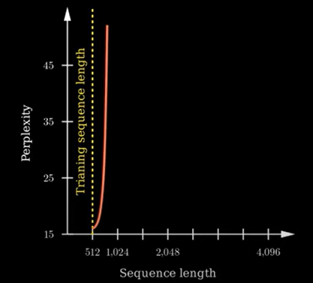
Sinusoidal Positional Encoding: Issues
To the transformer, the position vectors are just a bunch of numbers
Each vector represents an absolute position
What if a sequence of length greater than that of all the sequences used during training is fed during inference?
The transformer does not have any clue about the new positional index

Slide 21
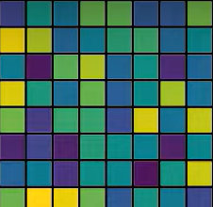
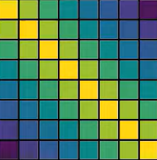





Rotary Positional Encoding
$$k_{1}$$ | $$k_{2}$$ | $$k_{3}$$ |  |  |  |  | $$k_{8}$$
$$a\left(m,n\right)=\left\|q_{m}\right\|.\left\|k_{n}\right\|$$
$$q_{1}$$
$$q_{2}$$
$$q_{3}$$
$$q_{8}$$
$$=q^{⊤}k$$
$$a\left(m,n\right)=Θ_{(n−m)}$$

Slide 22
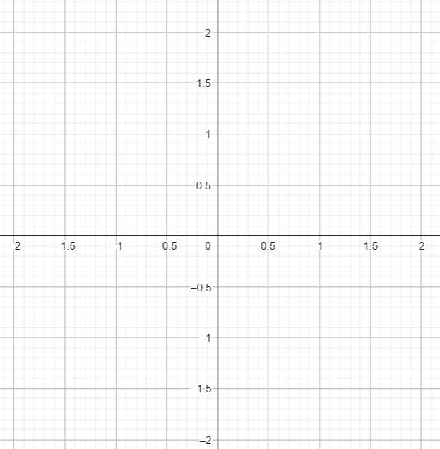





Rotary Positional Encoding
$$k_{m}$$
$$q_{m}$$
$$a\left(m,n\right)=\left\|q_{m}\right\|.\left\|k_{n}\right\|$$
$$θ_{n}$$
$$θ_{m}$$
$$a\left(m,n\right)=Θ_{(n−m)}$$
$$q_{m}$$

Slide 23



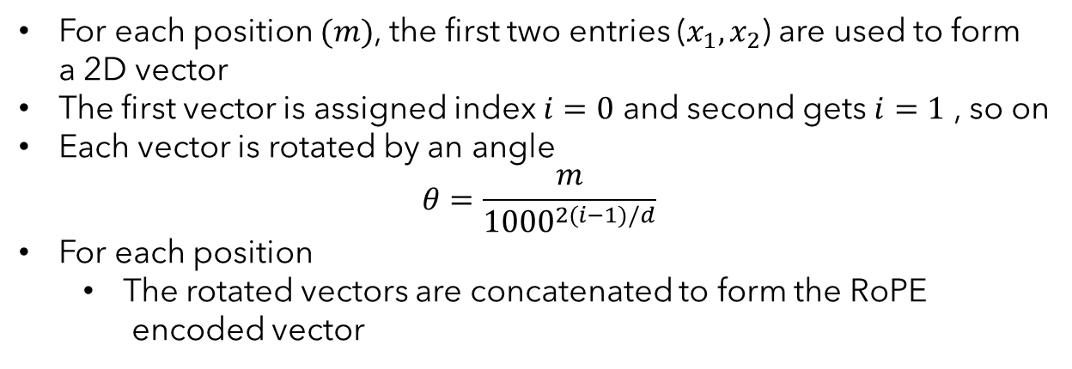





Rotary Positional Encoding
We defined the rotation in two dimensional space with a rotation matrix
The original embedding vector is divided into a set of 2D vectors (WHY?)
$$i=1$$
$$i=2$$
For each position $(m)$, the first two entries ($x_{1},x_{2}$) are used to form
a 2D vector
The first vector is assigned index $i=0$ and second gets $i=1$ , so on
Each vector is rotated by an angle
$$θ=\frac{m}{{1000}^{2(i−1)/d}}$$
For each position
The rotated vectors are concatenated to form the RoPE
encoded vector
Colorless
green
ideas
sleep
furiously
$$(x_{1}^{′},x_{2}^{′})$$
$$(x_{3}^{′},x_{4}^{′})$$
RoPE encoded embedding:
$$θ$$
$$(x_{1},x_{2})$$
$$θ$$
$$(x_{3},x_{4})$$

Slide 24
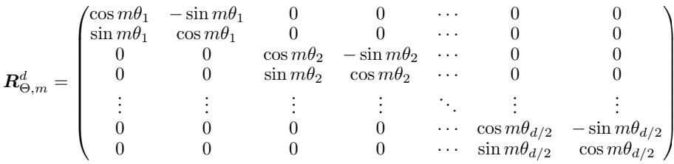

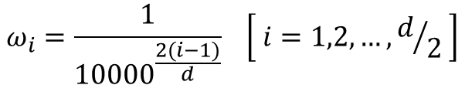
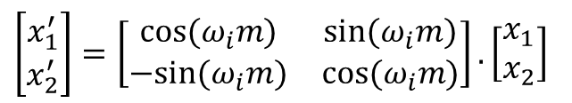
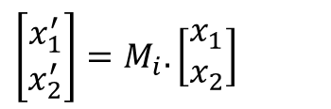
Rotary Positional Encoding
How to implement rotation?
$\left[\begin{matrix}x_{1}^{′} \\ x_{2}^{′}\end{matrix}\right]=M_{i}.\left[\begin{matrix}x_{1} \\ x_{2}\end{matrix}\right]$
$$ω_{i}=\frac{1}{{10000}^{\frac{2(i−1)}{d}}} \left[ i=1,2, …, d/2 \right]$$
$\left[\begin{matrix}x_{1}^{′} \\ x_{2}^{′}\end{matrix}\right]=\left[\begin{matrix}cos⁡(ω_{i}m) & sin⁡(ω_{i}m) \\ −sin⁡(ω_{i}m) & cos⁡(ω_{i}m)\end{matrix}\right].\left[\begin{matrix}x_{1} \\ x_{2}\end{matrix}\right]$
How to implement rotation for more than two dimensions?
How to compute RoPE embedding?

Slide 25
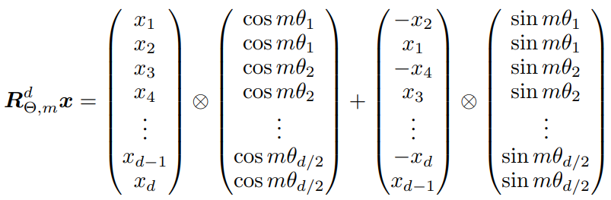
Rotary Positional Encoding
The original rotation matrix is sparse
An efficient implementation of rotation

Slide 26
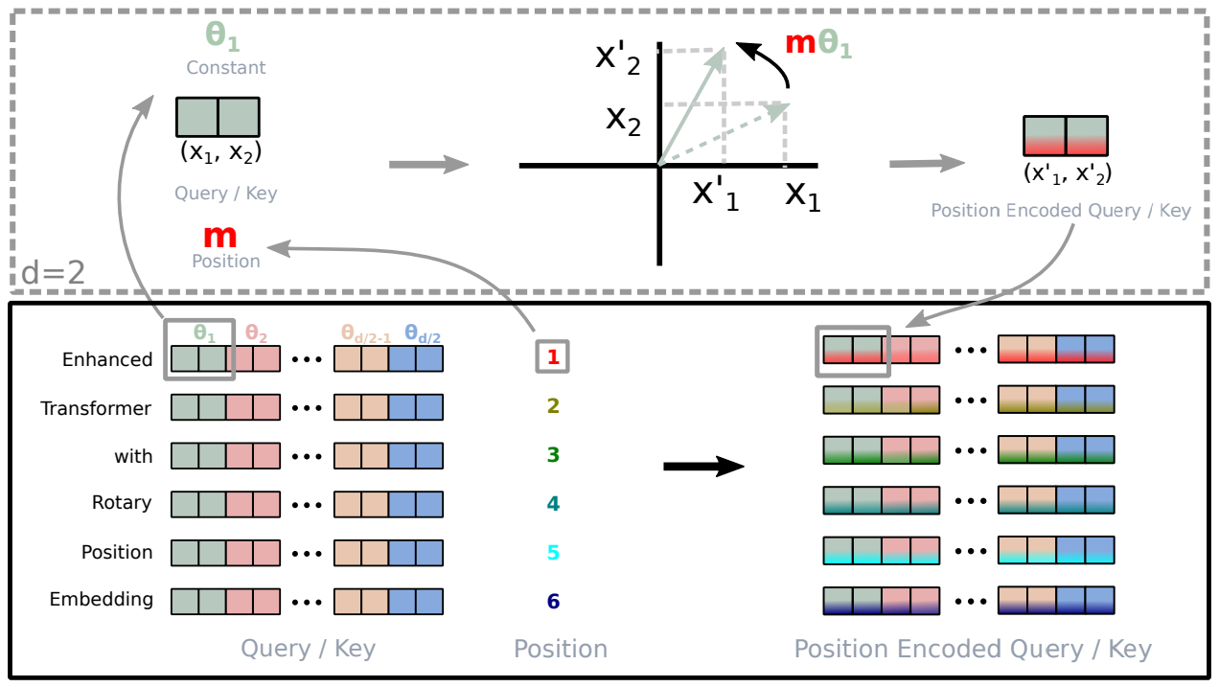
Rotary Positional Encoding

Slide 27


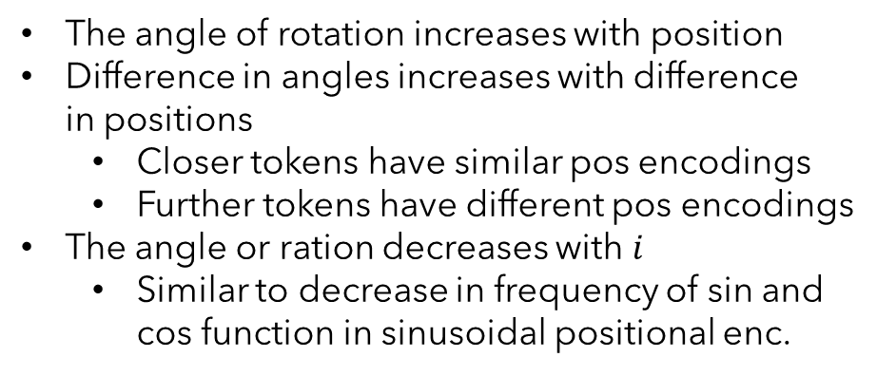


Rotary Positional Encoding
How does self attention look like now?
The self attention implicitly captures the relative distance between two tokens
$$θ=\frac{m}{{1000}^{2(i−1)/d}}$$
$$m$$
The angle of rotation increases with position
Difference in angles increases with difference
in positions
Closer tokens have similar pos encodings
Further tokens have different pos encodings
The angle or ration decreases with $i$
Similar to decrease in frequency of sin and
cos function in sinusoidal positional enc.
$$i$$

Slide 28



Rotary Positional Encoding
$$m$$
Lower index ($i$) captures minute local changes
$$i$$
I just told her the truth
I told just her the truth
Higher index ($i$) captures long dependence
Einstein developed the theory of relativity.
Through this breakthrough physics was
redefined by him.

Slide 29
Use of Positional Encoding
Sinusoidal Positional Encoding
BERT, T5,
RoPE is state of the art
DeepSeek, GPT-4o (?), GPT-Neo, GPT-J, LLaMA, LLaMA-2, LLaMA-3, Claude (?), Falcon
Learned Positional Encoding
GPT-2
No positional encoding (NoPE)
Interleaved RoPE (iRoPE)
Interleave between RoPE and NoPE layers
https://deerajmanjaray.medium.com/llama-4s-approach-to-positional-information-0eb736179e5f

Slide 30
Transformers: Advanced Topics
Transformers: Advanced Topics
Different Attention Models
(Making inference faster)

Slide 31
Key-Value Cache
Auto-regressive Model

Slide 32
Key-Value Cache
KV caching occurs during multiple token generation steps and only happens in the decoder (causal attention)

Slide 33



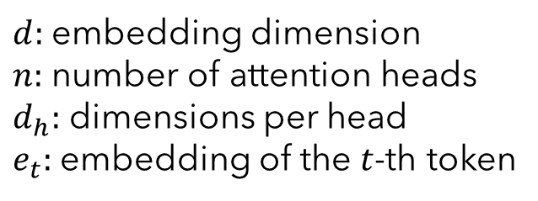


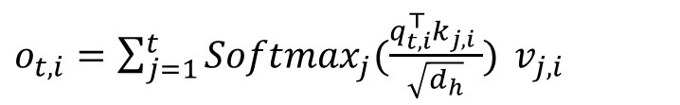

Standard Multi-Head Attention
$d:$ embedding dimension
$n:$ number of attention heads
$d_{h}:$ dimensions per head
$e_{t}:$ embedding of the $t$-th token
1
Computation of Query ($q_{t}$), Key ($k_{t}$) and Value ($v_{t}$)
$$q_{t}=W_{Q}e_{t}, k_{t}=W_{K}e_{t}, v_{t}=W_{V}e_{t}$$
2
Slicing $q_{t}, k_{t}$and $v_{t}$ into $n$ heads
3
Compute slice-wise scaled dot product and context vector
$$[q_{t,1};q_{t,2};…q_{t,n}]=q_{t}$$
$$[k_{t,1};k_{t,2};…k_{t,n}]=k_{t}$$
$o_{t,i}=\sum_{j=1}^{t}{Softmax_{j}(\frac{q_{t,i}^{⊤}k_{j,i} }{\sqrt{d_{h}}})} v_{j,i}$
$$[v_{t,1};v_{t,2};…v_{t,n}]=v_{t}$$
$$q_{t,i},k_{t,i},v_{t,i}∈ℝ^{d_{h}}$$
4
Concatenate the output from each slice
$$u_{t}=W_{O}[o_{t,1};o_{t,2};…o_{t,n}]$$

Slide 34





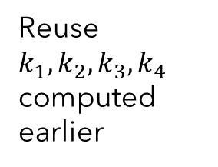

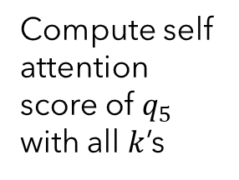

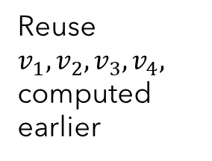
Key-Value Cache
Let’s say we have already generated four tokens and processing the 5th
Let us backtrack
$$Q$$
$$K^{⊤}$$
$${QK}^{⊤}$$
$$V$$
logits
$$×$$
$$=$$
$$×$$
Reuse $k_{1}, k_{2}, k_{3}, k_{4}$ computed earlier
Compute self attention score of $q_{5}$ with all $k$’s
Reuse $v_{1}, v_{2},v_{3},v_{4},$ computed earlier
Compute the logit for 5th token
The 5th token
Previously computed KEYs can be reused
Previously computed VALUEs can be reused
Key-Vale Cache

Slide 35
Key-Value Cache

Slide 36
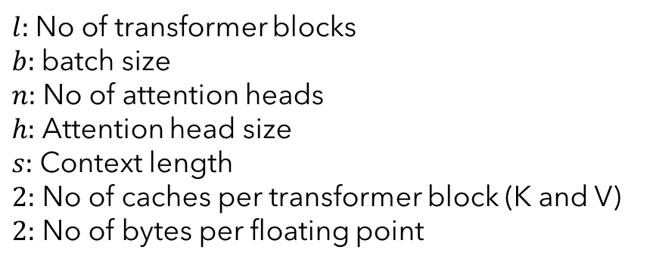

Key-Value Cache: What’s the Catch?
Size of the KV Cache
without KV cache (quadratic)
KV cache size $=l∗b∗n∗h∗s∗2∗2$
compute
$l:$No of transformer blocks
$b:$batch size
$n:$ No of attention heads
$h:$ Attention head size
$s:$ Context length
$2:$ No of caches per transformer block (K and V)
$2:$ No of bytes per floating point
With KV cache (linear)
Input token size
Size of the KV Cache of DeepSeek R1/V3
$$l=61, b=1, n=128, h=128, s=100000$$
We need extra storage to store previously computed keys and values
KV Cache size = 400GB
Can we reduce the KV cache size?

Slide 37
KV Cache vs Standard Inference
Feature | Standard Inference | KV Caching
Computation per Word | The model repeats the same calculations for every word. | The model reuses past calculations for faster results.
Memory Usage | Uses less memory at each step, but memory grows with longer texts. | Uses extra memory to store past information, but keeps things efficient.
Speed | Gets slower as the text gets longer because it repeats work. | Stays fast even with longer texts by avoiding repeated work.
Efficiency | High computational cost and slower response times. | Faster and more efficient since the model remembers past work.
Handling Long Texts | Struggles with long texts due to repeated calculations. | Perfect for long texts as it remembers past steps.

Slide 38
KV Cache: Points to Ponder
Why don’t we cache the queries?
What can you say about the latency of the first token to be generated in response to a longer prompt?

Slide 39
KV Caching: Resources
KV Caching Explained: Optimizing Transformer Inference Efficiency
https://huggingface.co/blog/not-lain/kv-caching
Transformers KV Caching Explained
https://medium.com/@joaolages/kv-caching-explained-276520203249

Slide 40
























Multi Query Attention (MQA)
KV Cache Issue: Longer context requires larger KV cache
Can we reduce the cache size?
$$h_{1}$$
$$h_{2}$$
$$h_{3}$$
$$h_{4}$$
What if K’s and V’s for all the heads are the same?
$$K_{1}$$
$$K_{2}$$
$$K_{3}$$
$$K_{4}$$
$$W_{K1}$$
$$W_{K2}$$
$$W_{K3}$$
$$W_{K4}$$
(5,2)
(5,2)
(5,2)
(5,2)
(8,2)
(8,2)
(8,2)
(8,2)
We don’t need to cache the K’s or V’s
$$Q_{1}$$
$$Q_{2}$$
$$Q_{3}$$
$$Q_{4}$$
$$V_{1}$$
$$V_{2}$$
$$V_{3}$$
$$V_{4}$$
(5,2)
(5,2)
(5,2)
(5,2)
(5,2)
(5,2)
(5,2)
(5,2)
$$W_{V1}$$
$$W_{V2}$$
$$W_{V3}$$
$$W_{V4}$$
(8,2)
(8,2)
(8,2)
(8,2)

Slide 41



















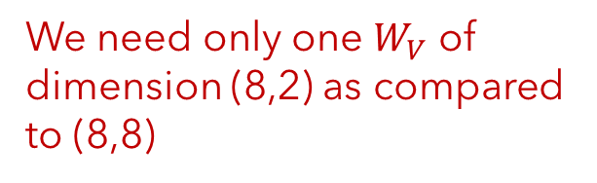






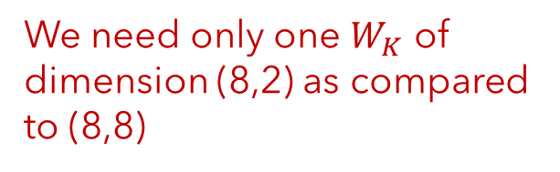

Multi Query Attention (MQA)
KV Cache Issue: Longer context requires larger KV cache
Can we reduce the cache size?
$$h_{1}$$
$$h_{2}$$
$$h_{3}$$
$$h_{4}$$
We need only one $W_{K}$ of dimension (8,2) as compared to (8,8)
We need only one $W_{V}$ of dimension (8,2) as compared to (8,8)
$$K_{1}$$
$$K_{2}$$
$$K_{3}$$
$$K_{4}$$
$$W_{K1}$$
$$W_{K2}$$
$$W_{K3}$$
$$W_{K4}$$
(5,2)
(5,2)
(5,2)
(5,2)
(8,2)
(8,2)
(8,2)
(8,2)
Store only one $K$and $V$
$$Q_{1}$$
$$Q_{2}$$
$$Q_{3}$$
$$Q_{4}$$
$$V_{1}$$
$$V_{2}$$
$$V_{3}$$
$$V_{4}$$
KV cache size $=l∗b∗h∗s∗2∗2$
(5,2)
(5,2)
(5,2)
(5,2)
(5,2)
(5,2)
(5,2)
(5,2)
$$W_{V1}$$
$$W_{V2}$$
$$W_{V3}$$
$$W_{V4}$$
(8,2)
(8,2)
(8,2)
(8,2)

Slide 42
Multi Query Attention (MQA)
Attention Mechanism Type | Size of KV Cache | GTP-3 (175B, l=96, n=96) | DeepSeek (n=128)
Multi Head Attention (MHA) | l*b*n*h*s*2*2 | 4.5 GB (96x) | 400GB (128x)
Multi Query Attention (MQA) | l*b*h*s*2*2 | 48 MB | 3GB
What is the trade off?
Similar to performing a single head attention (self-attention)
Multi-Head Attention aims to capture different perspectives
of the same input
Degradation in performance

Slide 43
Group Query Attention (GQA)
MHA requires large cache size while showing better performance
MQA requires small cache size while showing degraded performance
GQA adopts a middle ground by reducing the cache size while holding the performance level

Slide 44

























Group Query Attention (GQA)
$$h_{1}$$
$$h_{2}$$
$$h_{3}$$
$$h_{4}$$
Group 1
Group 2
The heads are grouped
$$K_{1}$$
$$K_{2}$$
$$K_{3}$$
$$K_{4}$$
All the heads in a group share the
parameters
$$W_{K1}$$
$$W_{K2}$$
$$W_{K3}$$
$$W_{K4}$$
(5,2)
(5,2)
(5,2)
(5,2)
(8,2)
(8,2)
(8,2)
(8,2)
$$Q_{1}$$
$$Q_{2}$$
$$Q_{3}$$
$$Q_{4}$$
$$V_{1}$$
$$V_{2}$$
$$V_{3}$$
$$V_{4}$$
KV cache size $=l∗b∗g∗h∗s∗2∗2$
(5,2)
(5,2)
(5,2)
(5,2)
(5,2)
(5,2)
(5,2)
(5,2)
$$W_{V1}$$
$$W_{V2}$$
$$W_{V3}$$
$$W_{V4}$$
(8,2)
(8,2)
(8,2)
(8,2)

Slide 45
Group Query Attention (MQA)
Attention Mechanism Type | Size of KV Cache | GTP-3 (175B, l=96, n=96) | DeepSeek (n=128)
Multi Head Attention (MHA) | l*b*n*h*s*2*2 | 4.5 GB (96x) | 400GB (128x)
Multi Query Attention (MHA) | l*b*h*s*2*2 | 48 MB | 3GB
Group Query Attention (GQA) | l*b*g*s*2*2 | 384 MB (8 groups)

Slide 46
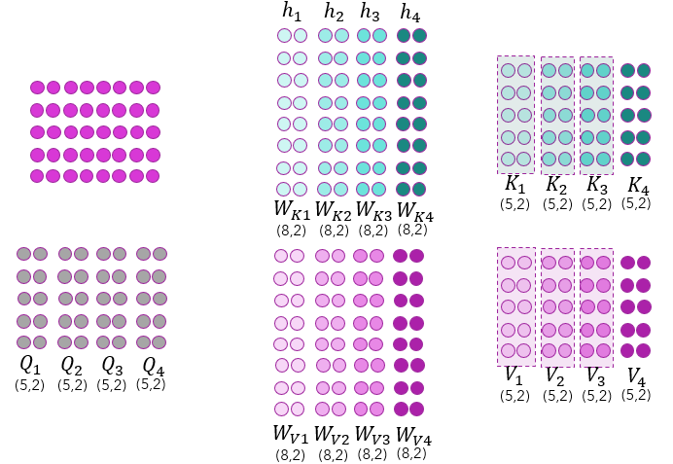
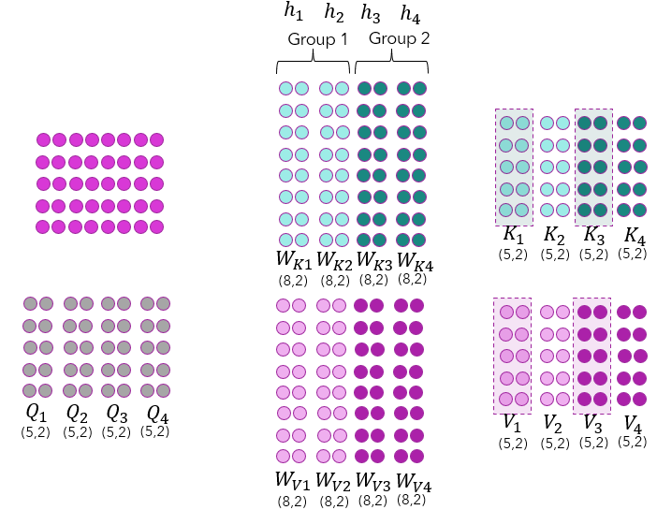
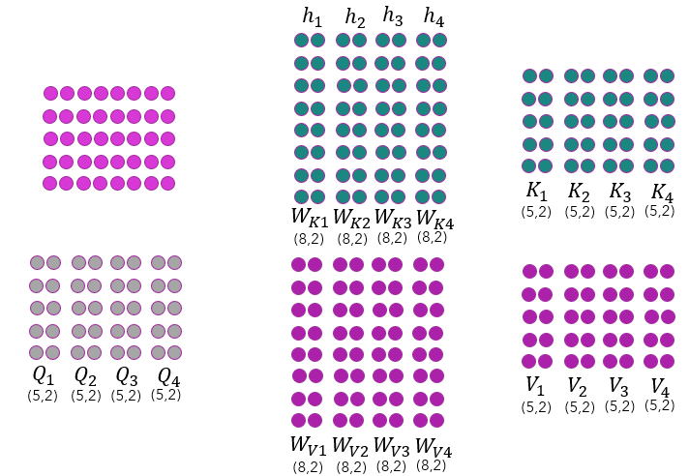
Multi-Head Latent Attention (MLA)
How do we strike a trade-off between KV Cache size and
language model performance?
Expressive models tend to show better performance → Parameter sharing won’t help
Full Caching
Group Query
Multi Query
Worst in cache size,
Best in performance
Moderate in cache size,
Moderate in performance
Best in cache size,
Worst in performance
Can we design an attention mechanism that has low cache size
but has better performance?

Slide 47
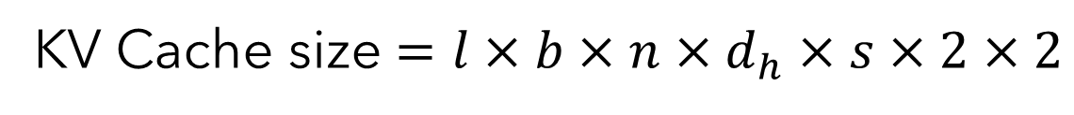
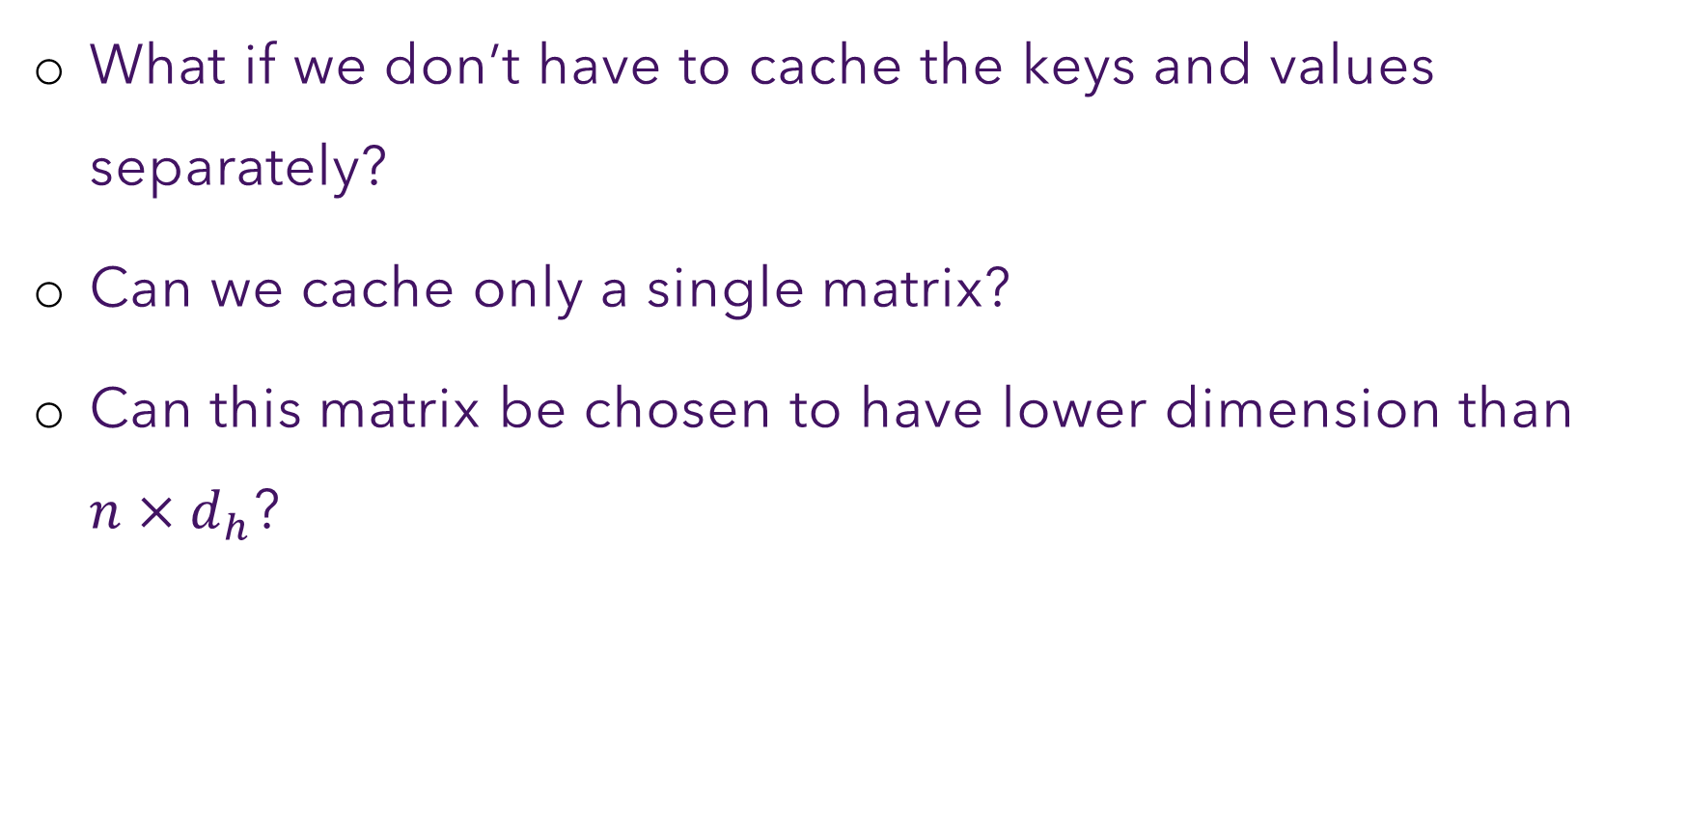
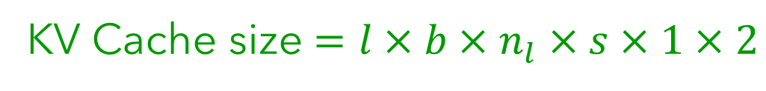
Multi-Head Latent Attention (MLA)
What if we don’t have to cache the keys and values separately?
Can we cache only a single matrix?
Can this matrix be chosen to have lower dimension than $n×d_{h}$?
KV Cache size $=l×b×n×d_{h}×s×2×2$
KV Cache size $=l×b×n_{l}×s×1×2$

Slide 48














Workflow for Normal KV Cache
Consider that 4 tokens have already been generated and the decoder is to spit out the 5th token
$$X_{5}$$
$$∗W_{K}$$
$$K_{5}$$
(1,8)
(8,4)
(1,4)
$$Q_{5}K^{⊤}$$
$$∗W_{Q}$$
$$∗$$
(1,5)
$$X_{5}$$
$$Q_{5}$$
(1,8)
(8,4)
(1,4)
$$K_{5}$$
$$∗$$
$$X_{5}$$
$$∗W_{V}$$
$$V_{5}$$
(1,8)
(8,4)
(1,4)
$$V_{5}$$
Context vector
(1,4)

Slide 49
Multi-Head Latent Attention (MLA)
How to capture the information of a larger dimension matrix
in a lower dimension matrix?
Latent Space

Slide 50

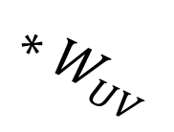



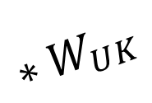

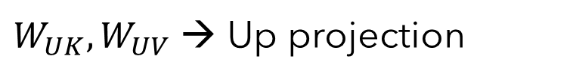








Multi-Head Latent Attention (MLA)
$$Q$$
. Low-Rank Key-Value Joint Compression
$$∗W_{Q}$$
$$X$$
(8,8)
Attention matrix
(4,8)
(4,8)
$$∗$$
$$∗$$
$$Q^{⊤}K$$
$$W_{DKV}$$
(8,4)
$$K$$
$$∗W_{UK}$$
cached
(4,8)
(4,8)
(4,8)
$$C_{KV}$$
$$∗W_{O}$$
(8,8)
$$V$$
(4,4)
$$∗W_{UV}$$
$$∗$$
(4,8)
(4,8)
(4,8)
$W_{UK}, W_{UV}$ → Up projection
Context matrix
$W_{DKV}$→ Down Projection

Slide 51

MLA Computation
Query projection: $Q=XW_{Q}$
Down Projection: $C_{KV}=XW_{DKV}$
[$W_{DKV}∈ℝ^{n∗d_{h}×d_{c}}, C_{KV}∈ℝ^{d_{c}×d_{c}}, d_{c}≪n∗d_{h}$]
Key and Value matrices
$K=C_{KV}W_{UK}=XW_{DKV}W_{UK}[W_{UK}∈ℝ^{d_{c}×n∗d_{h}}]$
$V=W_{UV}C_{KV}=XW_{DKV}W_{UV}[W_{UV}∈ℝ^{d_{c}×n∗d_{h}}]$
Attention score
$QK^{⊤}=\left(XW_{Q}\right){\left(XW_{DKV}W_{UK}\right)}^{⊤}=\left(XW_{Q}\right)\left(W_{UK}^{⊤}W_{DKV}^{⊤}X^{⊤}\right)=X\left(W_{Q}W_{UK}^{⊤}\right){\left(XW_{DKV}\right)}^{⊤}$
$=X\left(W_{Q}W_{UK}^{⊤}\right){\left(C_{KV}\right)}^{⊤}$

Slide 52





MLA Computation
$QK^{⊤}=X$ $\left(W_{Q}W_{UK}^{⊤}\right)C_{KV}^{⊤}$
$W_{UK}$ is absorbed into $W_{Q}$ → These two matrices are fixed after pretraining. Hence, $W_{Q}W_{UK}^{⊤}$ can be precomputed only once
Output embedding:
$\left(QK^{⊤}\right)VW_{O}=\left(QK^{⊤}\right)$ $XW_{DKV}W_{UV}W_{O}$
$$=\left(QK^{⊤}\right)(XW_{DKV})(W_{UV}W_{O})$$
$$=\left(QK^{⊤}\right) (C_{KV})(W_{UV}W_{O})$$
$W_{UV}$ is absorbed into $W_{O}$ → These two matrices are fixed after pretraining. Hence, $W_{UV}W_{O}$ can be precomputed only once

Slide 53










MLA Computation: Visualization
Consider that 4 tokens have already been generated and the decoder is to spit out the 5th token
$QK^{⊤}= X$ $\left(W_{Q}W_{UK}^{⊤}\right)C_{KV}^{⊤}$
$$X$$
(4,8)
1
Compute the absorbed query
2
Compute the $C_{KV}$ vector for $X_{5}$
$$Q_{5}^{′}=X_{5}(W_{Q}W_{UK}^{⊤})$$
$$C_{KV}^{(5)}=X_{5}W_{DKV}$$
(1,4)
(1,8)
(8, 8)
(8, 4)
(1,4)
(1,8)
(8, 4)
3
Append the $C_{KV}^{(5)}$ to existing $C_{KV}$
Computing attention vector for $X_{5}$
4
$$A_{5}=Q_{5}^{′}C_{KV}^{⊤}$$
(1,5)
(1,4)
(4,5)
5
Computing output projection for $X_{5}$
(4,4)
(5,4)
$$L_{5}=A_{5}C_{KV}\left(W_{UV}W_{O}\right)$$
(1,8)
(1,5)
(5,4)
(4, 8)
(8, 8)

Slide 54




Applying RoPE with MLA
MLA stands on the idea of absorption of $W_{UK}$ into $W_{Q}$ and that of $W_{UV}$ into $W_{O}$
Attention using RoPE embedded queries and keys
$${\left(R_{i}^{Q}W_{Q}x_{i}\right)}^{⊤}\left(R_{1…i}^{K}W_{K}x_{1…i}\right)=x_{i}^{⊤}W_{Q}^{⊤}R_{i}^{Q^{⊤}}R_{1…i}^{K}W_{K}x_{1…i}$$
$$q_{i}$$
$$k_{i}$$
$R_{i}^{Q}$ is changing for each input at inference time
$W_{Q}^{⊤}R_{i}^{Q^{⊤}}R_{1…i}^{K}W_{K}$ cannot be precomputed or absorbed
Idea: Use different channel for positional encoding
Decoupled Rotary Position Embedding

Slide 55







MLA in DeepSeek-V2
Only during training
DeepSeeek-AI, DeepSeek-V2: A Strong, Economical, and Efficient Mixture-of-Experts Language Model

Slide 56












MLA in DeepSeek-V2
During Inference

Slide 57

MLA in DeepSeek-V2
Attention Mechanism Type | Size of KV Cache per token (# Elements) | Capability
Multi Head Attention (MHA) | $$2∗l∗n∗d_{h}$$ | Strong
Multi Query Attention (MQA) | $$2∗{l∗n}_{g}∗d_{h}$$ | Weak
Group Query Attention (GQA) | $$2∗l∗d_{h}$$ | Moderate
Multi-Head Latent Attention (MLA) | $$l∗(d_{c}+d_{h}^{h})$$ | Stronger
Multi-Head Latent Attention (MLA) | $$\left(4d_{h}+\frac{d_{h}}{2}\right)∗l=\frac{9}{2}d_{h}∗l$$ | Stronger

Slide 58
Resources
Attention is All You Need
Vaswani et al.
https://arxiv.org/abs/1706.03762
RoFormer: Enhanced Transformer with Rotary Position Encoding
https://arxiv.org/pdf/2104.09864
You could have designed state of the art positional encoding
https://huggingface.co/blog/designing-positional-encoding
DeepSeek
https://arxiv.org/pdf/2405.04434

